Slide 1
Lsetf/giz 8th gear inkeeper
DATA ANALYSIS PROJECT

Slide 2
Finance dataset budgetwise financial overview(2021-2024)
Presented by Group 5

Slide 3

Summary
The BudgetWise dataset (2021–2024) tracks personal finances and spending patterns. This dashboard provides insights into total income vs. expenses, monthly trends, top spending categories (Rent, Food, Travel), regional expenditure, and payment methods. These insights support:
Budget transparency
Cash-flow planning
Spending habit improvement
Cost optimization
Financial equity & lifestyle balance

Slide 4
Dataset Overview:
Data Fields
DESCRIPTION
Earnings Data | Amount, income
Personal Info | Region, Payment mode and category
Time Dimension | Month-Year,Year

Slide 5
SOURCE OF DATA
Dataset Name: Budgetwise finance dataset(2021– 2024)
Source Link: Kaggle.com (Search: “Finance Dataset")
Departments Involved:
Department of Personal Finance

Slide 6
tools
POWER QUERY
For initial data cleaning, transformation, and exploring data types.
MICROSOFT EXCEL
For building interactive dashboards with custom KPIs, visualization, and filter.

Slide 7
PROBLEM statement
Budget transparency
Cash-flow forecasting
Habit optimization
Cost reduction strategies
Financial equity across essentials vs. discretionary spends

Slide 8
Key Tracking Metrics
Metric
Description
Total Amount
Total Expenses
Total Income
Monthly Trend
Sum of all inflows/outflows
Cumulative outflows
Cumulative inflows
Transaction over Months

Slide 9
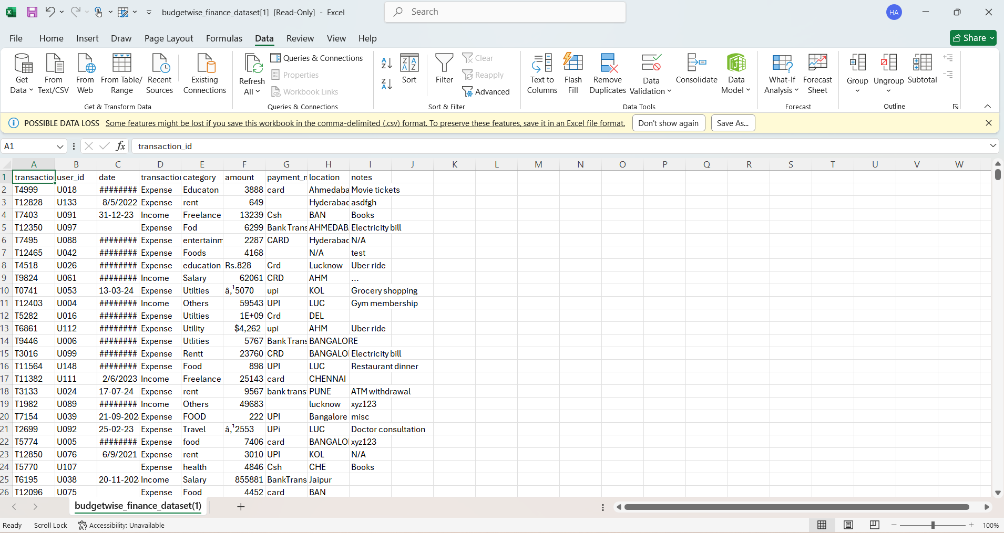
RAW DATASET

Slide 10
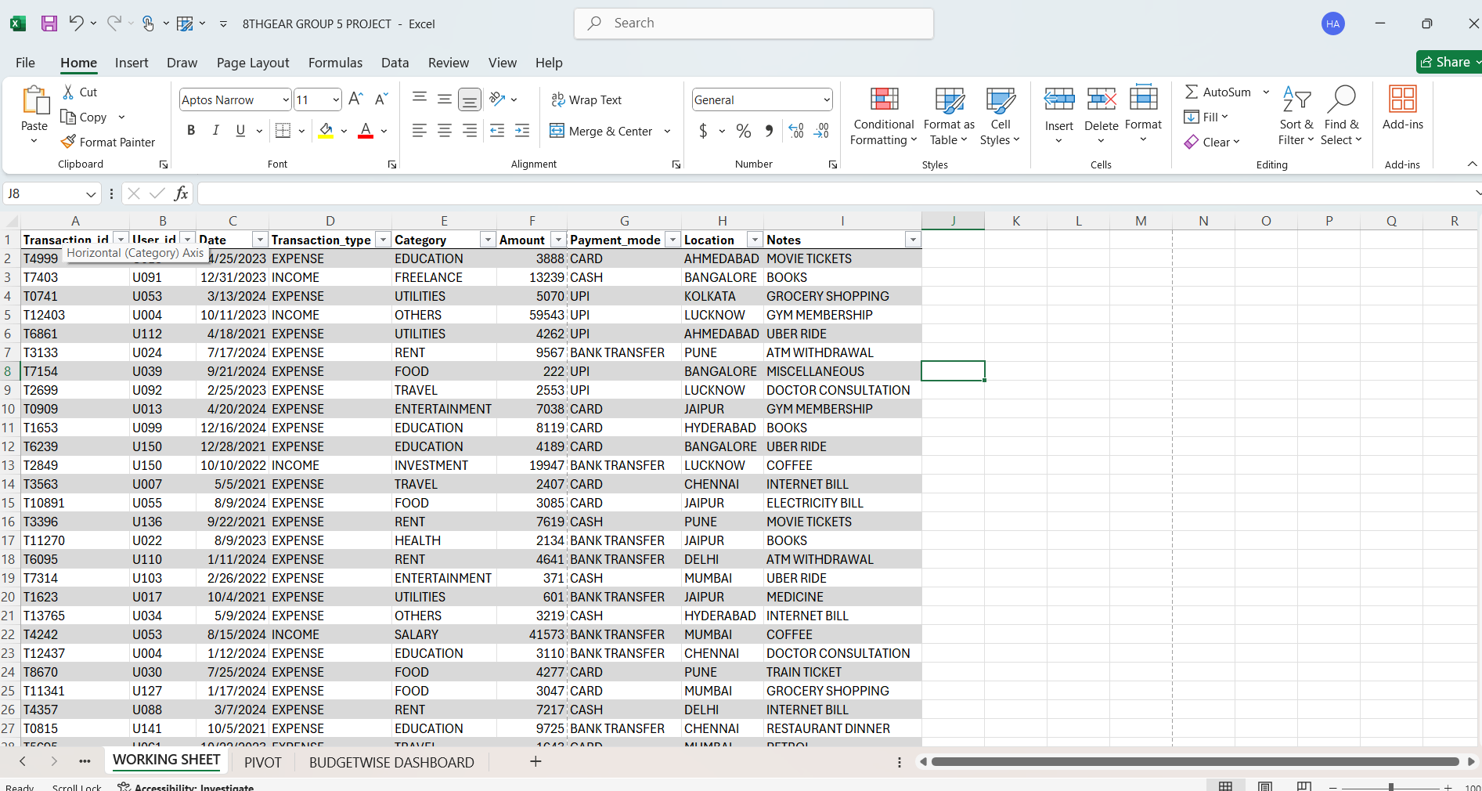
CLEANED DATASET

Slide 11
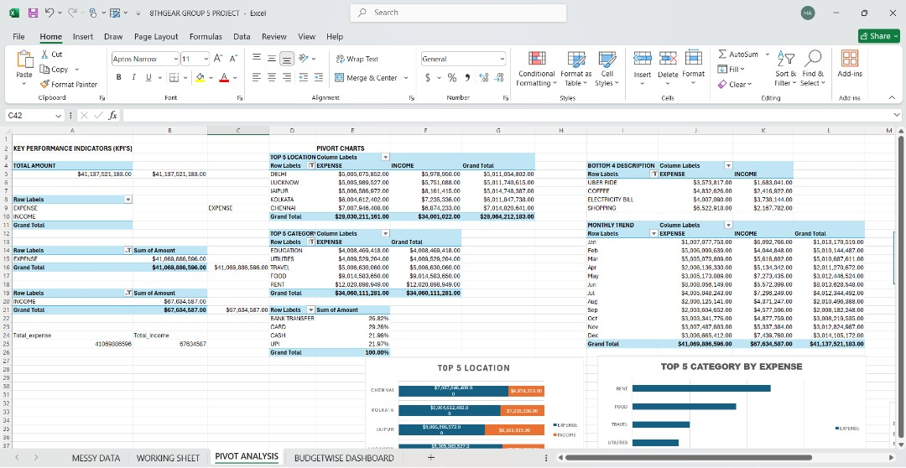
PIVOT ANALYSIS

Slide 12
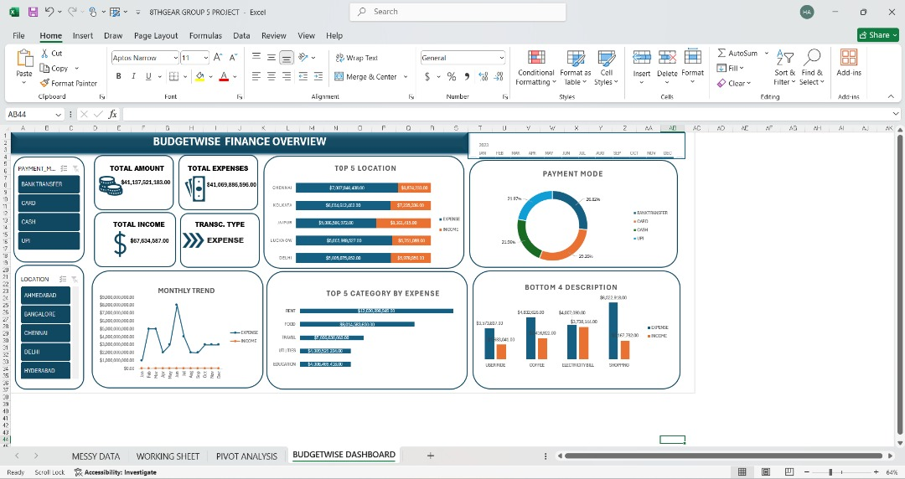
DATA VISUALIZATION

Slide 13
REPORT SUMMARY
Project Summary
Analyze 4 years of personal finance transactions to detect spending imbalances, optimize cash flow, and enable sustainable budgeting.
Dataset: Daily records of $41.069B expenses vs. $67.6M income, categorized by region, payment mode, and type.
Analysts’ Focus
• Expense drivers (Rent/Food at 66% of total).
• Income-expense gaps (12% coverage).
• Trends (15% YoY inflation; seasonal spikes).
• Efficiency (regional overspends in Chennai; Cash payment waste).
Key Data Preparation Steps
1. Import & Clean: Load transactions; handle negatives (expenses) vs. positives (income).
2. Categorize: Standardize categories.
3. Aggregate: Sum by month/year/region
4. Validate: Remove duplicates; flag outliers

Slide 14
The data reveals major financial imbalances with expenses far outweighing income, driven mainly by Rent and Food. Chennai shows the highest spending due to urban living costs. Bank Transfers dominate payments, while Cash use causes inefficiencies and missed rewards. Expenses rise yearly, spiking seasonally with travel and activities. Health spending is critically low, risking future costs. Opportunities include cutting essential expenses, diversifying income, and regular audits to control discretionary spending for better financial stability.
KEY INSIGHTS

Slide 15
Reduce Rent and Food expenses to free up cash flow Shift cash payments to card or bank transfers to gain rewards and improve tracking Diversify income sources to increase overall earnings Implement quarterly budget audits to monitor and limit discretionary spending
Increase health-related spending proactively to avoid costly emergencies Plan for seasonal expense spikes to prevent lifestyle inflation.
RECOMMENDATIONS

